Slide 1



Open source w rld
ඞ
A NEW WAY TO SEE LIFE

Slide 2
O.S.W. API OPENSTREETMAP PLATFORM
ඞ
CLIMATIC REPRESENTATIONS API

Slide 3
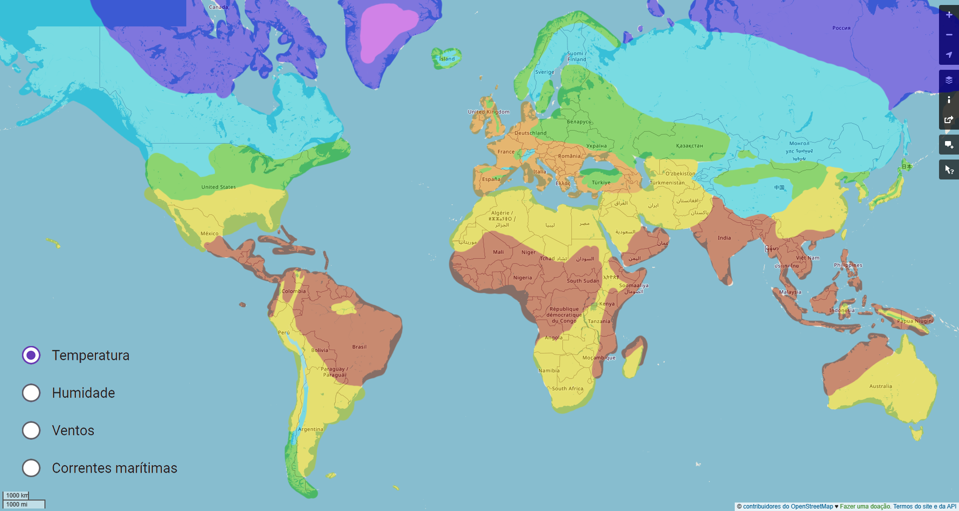
Heat Map
A way to visualize the map in our api is through the heat map, where it's possible to visualize in real time the whole world's temperature.
ඞ

Slide 4
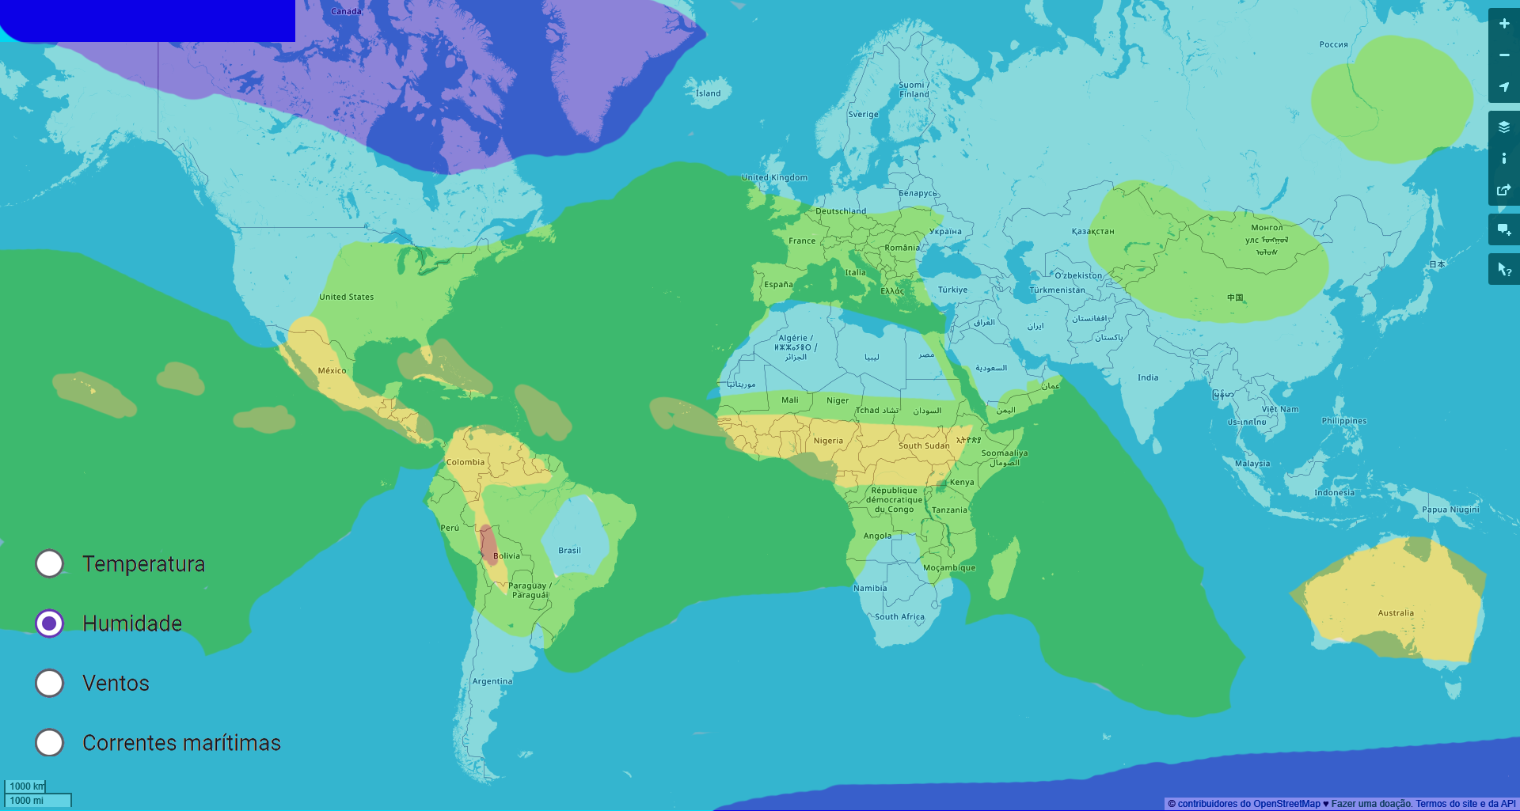
Humidity Map
ඞ
The Humidity map would show how the planet's general humidity currently is, showing where the focuses and lacks of water are at.

Slide 5
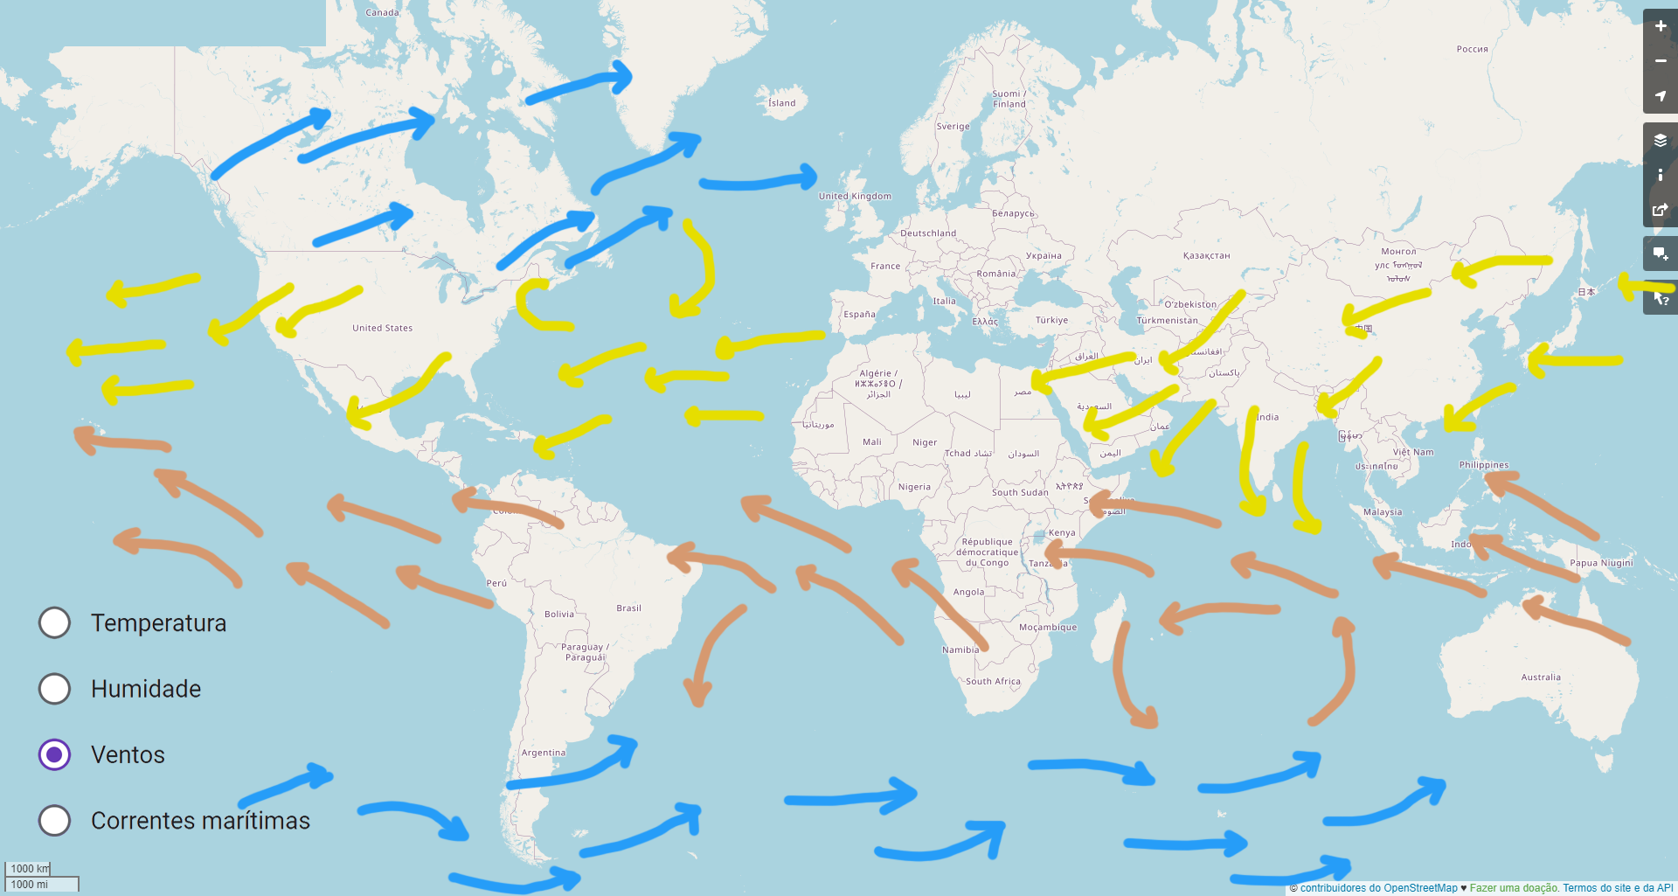
Wind Directions Map
The wind directions map would show with arrows the directions and velocity of sea and terrestrial winds.
ඞ

Slide 6
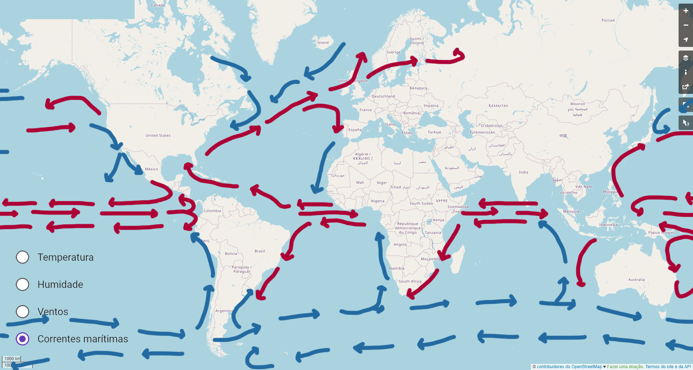
Sea Currents Map
The Sea Currents map shows in a visual manner all the sea currents.
ඞ

Slide 7
Open source w rld
ඞ
A NEW WAY TO SEE LIFE

Slide 8



Teඞm Members
Jordඞn Borges Dos Reis
Rudi Becker Neto
Lucas ඞrthur Cඞmpesඞtto Mellඞ

